Slide 1
Populate and Access Data in OneLake
Module 5

Slide 2
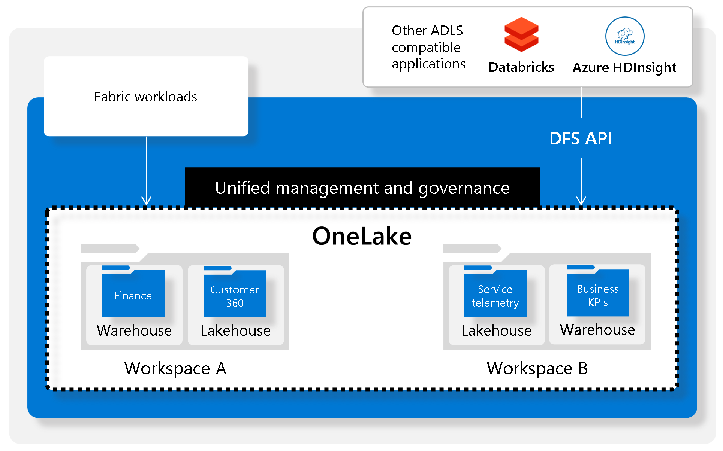
What is OneLake?
OneLake is a single, unified, logical data lake for your whole organization. Like OneDrive, OneLake comes automatically with every Microsoft Fabric tenant and is designed to be the single place for all your analytics data.
Notes:
OneLake is a single, unified, logical data lake for your whole organization. Like OneDrive, OneLake comes automatically with every Microsoft Fabric tenant and is designed to be the single place for all your analytics data. OneLake brings customers:
One data lake for the entire organization
One copy of data for use with multiple analytical engines
OneLake is open at every level. OneLake is built on top of Azure Data Lake Storage (ADLS) Gen2 and can support any type of file, structured or unstructured. All Fabric data items like data warehouses and lakehouses store their data automatically in OneLake in Delta Parquet format. If a data engineer loads data into a lakehouse using Spark, and then a SQL developer uses T-SQL to load data in a fully transactional data warehouse, both are contributing to the same data lake. OneLake stores all tabular data in Delta Parquet format.
OneLake supports the same ADLS Gen2 APIs and SDKs to be compatible with existing ADLS Gen2 applications, including Azure Databricks. You can address data in OneLake as if it's one big ADLS storage account for the entire organization. Every workspace appears as a container within that storage account, and different data items appear as folders within those containers.

Slide 3
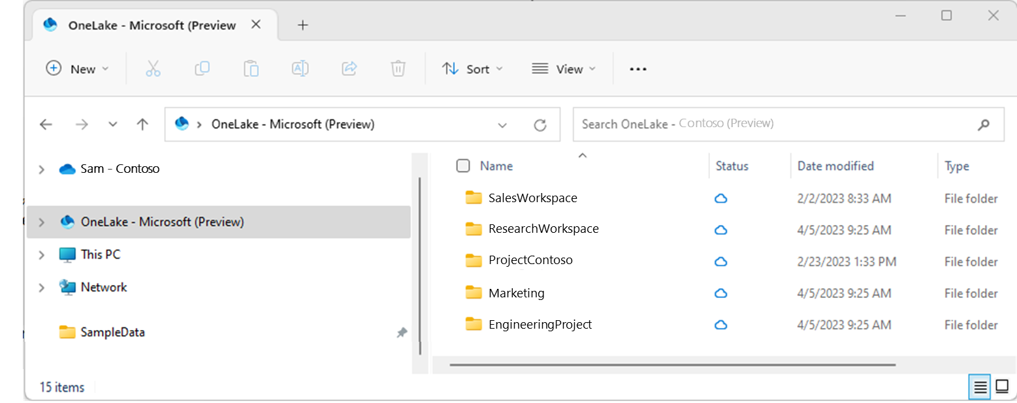
OneLake File Explorer for Windows
Easily explore OneLake data from Windows:
Navigate all your workspaces and data items
Upload, download, or modify files similar to working with Microsoft Office
Notes:
The OneLake file explorer application seamlessly integrates OneLake with Windows File Explorer. This application automatically syncs all OneLake items that you have access to in Windows File Explorer. "Sync" refers to pulling up-to-date metadata on files and folders, and sending changes made locally to the OneLake service. Syncing doesn’t download the data, it creates placeholders. You must double-click on a file to download the data locally.
When you create, update, or delete a file via Windows File Explorer, it automatically syncs the changes to OneLake service. Updates to your item made outside of your File Explorer aren't automatically synced. To pull these updates, you need to right-click on the item or subfolder in Windows File Explorer and select Sync from OneLake.

Slide 4
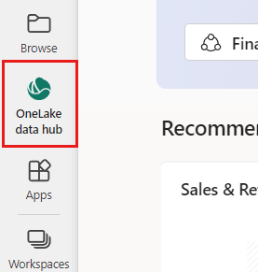
OneLake Data Hub
The data hub provides:
A filterable list of all the data items you can access
A gallery of recommended data items
A way of finding data items by workspace
A way to display only the data items of a selected domain
An options menu of things you can do with the data item
Notes:
The OneLake data hub makes it easy to find, explore, and use the Fabric data items in your organization that you have access to. It provides information about the items and entry points for working with them.
The data hub provides:
A filterable list of all the data items you can access
A gallery of recommended data items
A way of finding data items by workspace
A way to display only the data items of a selected domain
An options menu of things you can do with the data item
To open the data hub, select the OneLake data hub icon in the navigation pane.
The data items list displays all the data items you have access to. To shorten the list, you can filter by keyword or data-item type using the filters at the top of the list. You can also filter by workspace or domain. If you select the name of an item, you'll get to the item's details page. If you hover over an item, you'll see three dots that open the options menu when you select them.

Slide 5
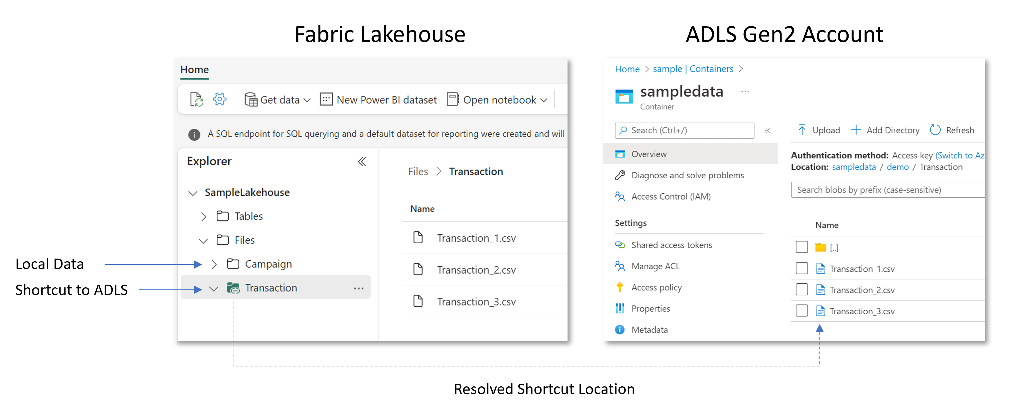
Shortcuts
A shortcut is a reference to data stored in other file locations.
Shortcuts connect data across domains without data movement
Shortcuts appear as folders in OneLake and any experience or service that has access to OneLake can use them.
Create shortcuts in Lakehouses or with KQL
Notes:
Shortcuts allow your organization to easily share data between users and applications without having to move and duplicate information unnecessarily. When teams work independently in separate workspaces, shortcuts enable you to combine data across different business groups and domains into a virtual data product to fit a user’s specific needs.
A shortcut is a reference to data stored in other file locations. These file locations can be within the same workspace or across different workspaces, within OneLake or external to OneLake in ADLS or S3. No matter the location, shortcuts make files and folders look like you have them stored locally. While applications may have separation of storage and computing, the data is often optimized for a single engine, which makes it difficult to reuse the same data for multiple applications. With Fabric, the different analytical engines (T-SQL, Spark, Analysis Services, etc.) store data in the open Delta Parquet format to allow you to use the same data across multiple engines.
You can create shortcuts in lakehouses and Kusto Query Language (KQL) databases. Furthermore, the shortcuts you create within these items can point to other OneLake locations, Azure Data Lake Storage (ADLS) Gen2, or Amazon S3 storage accounts.

Slide 6
OneLake Security
Layered security model built around the organizational structure of experiences within Microsoft Fabric
Based upon Entra ID (Azure AD) authentication
Fabric Workspace roles grant permissions in OneLake

Slide 7
OneLake File Permissions Granted by Workspace Roles
Capability | Admin | Member | Contributor | Viewer
View files in OneLake | Yes | Yes | Yes | No
Write files in OneLake | Yes | Yes | Yes | No

Slide 8
OneLake Item Security
Permission Name | Sharing text | Can view files in OneLake? | Can write files in OneLake? | Can read data through SQL endpoint?
Read | No share boxes selected | No | No | No
ReadData | Read all SQL endpoint data | No | No | Yes
ReadAll | Read all Apache Spark | Yes | No | No
Write | N/A, only available through workspace roles | Yes | Yes | Yes

Slide 9
Summary
OneLake is like OneDrive for Data
It’s based upon Azure Data Lake Storage
It provides a unified data hub and can be used with multiple tools and multiple types of Fabric compute
Shortcuts allow you to create references to data without making a copy of it
OneLake File Explorer provides a user interface to explore data in OneLake
Layered security based upon workspace roles
Permissions to individual items can be granted separately

Slide 10

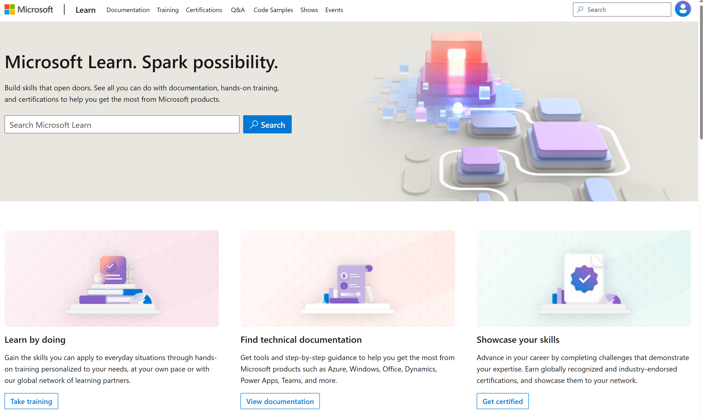
Microsoft Learn Demo
Microsoft Learn: Build skills that open doors in your career

Slide 11
Readiness and Enablement Links
The Microsoft Federal Team is here to help you accelerate customers' digital transformation. Microsoft Federal has tailored to make your organizations skilling journey successful. From the Business Decision Maker to the technical community and end-users, Microsoft provides customers with access to endless skilling resources. Below you will find links to these resources:
Get training tailored to your organization's needs: Find learning paths for specific roles in your organization, plus course recommendations based on technology, skill level, and solution area: Training | Learning Portal (microsoft.com)
Events Calendar - US Partner Community Blog – Microsoft
In addition to the above, the Microsoft Federal Team can address the needs of your non-technical community of your learners through:
Skilling Hours - Readiness and Enablement: Skilling our Federal Customers and Partners (office.com)
Microsoft Learning Portal: A closer look at Azure through training modules and gamified learning
Microsoft Learning Portal
Additional Learning Resources:
Get started with Azure – Introduction | Microsoft Azure
Microsoft Learn (path-based)
Exam-based: Select filters: Azure, D365, M365, Power Platform, and more
Microsoft Virtual Training Days – Virtual Instructor Led
Microsoft Technology Center - Work through your Account Manager
Home - Microsoft Tech Community
Microsoft Reactor | Microsoft Developer – Virtual Instructor Led

